Slide 1

Notes:
Most images comes from Envato Elements which I have a paid license for. Some images are my own, and the cartoon portrait and coding after work logo are purchased from an artist with the license to use it ☺

Slide 2


Practical tips to elevate your UX and accessibility
Jessica Engstrom
@EngstromJess

Slide 3
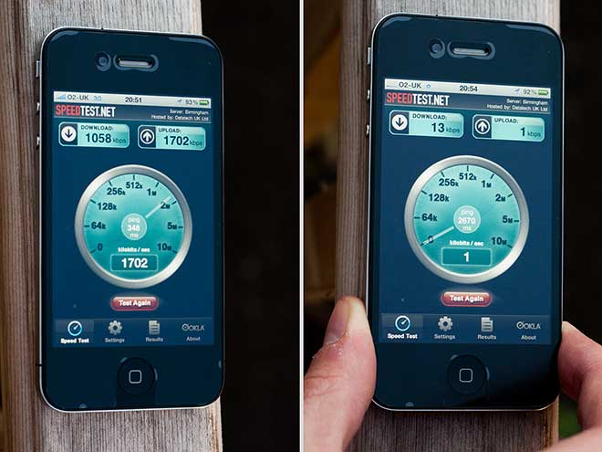

Slide 4
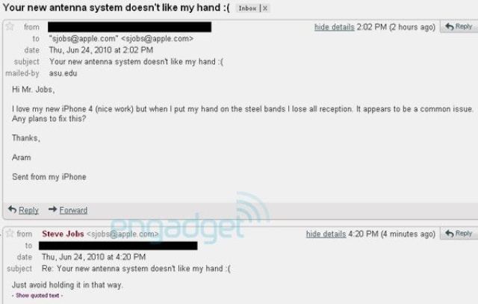

Slide 5
“If a necessary feature has a high astonishment factor, it may be necessary to redesign the feature.” The principle of least astonishment

Slide 6
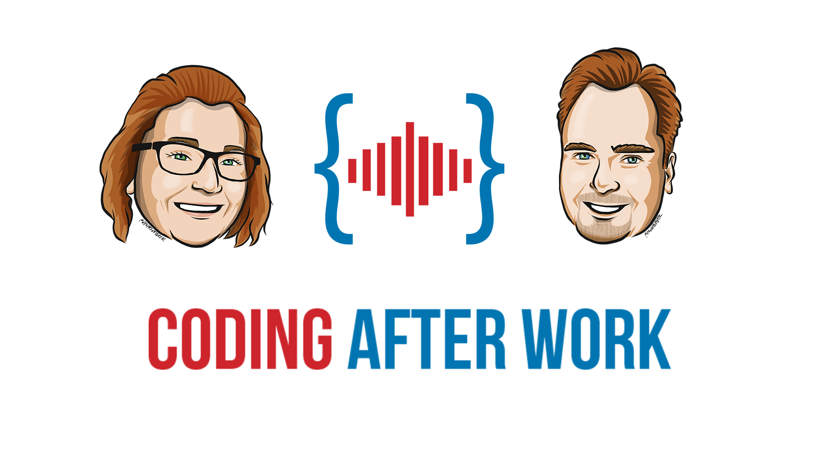


Slide 8
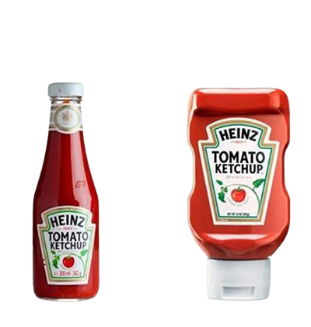
UI
UX

Slide 9
Before UX
After UX

Slide 10
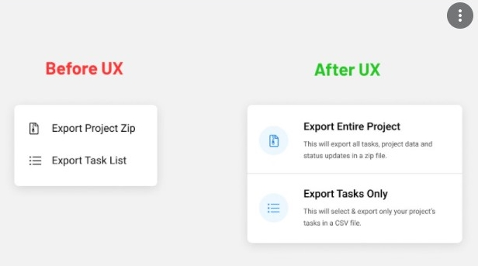
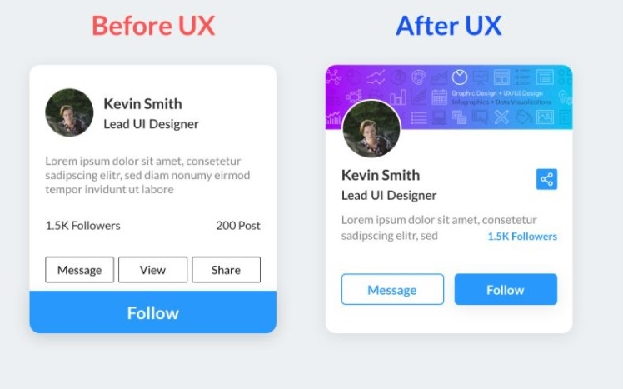
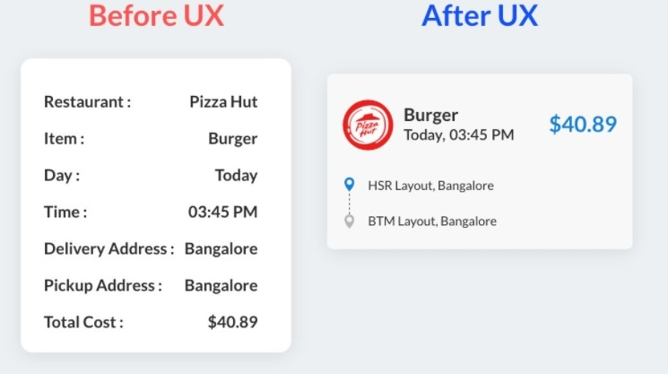

Slide 11
Before UX
After UX

Slide 12
UI
UI

Slide 13
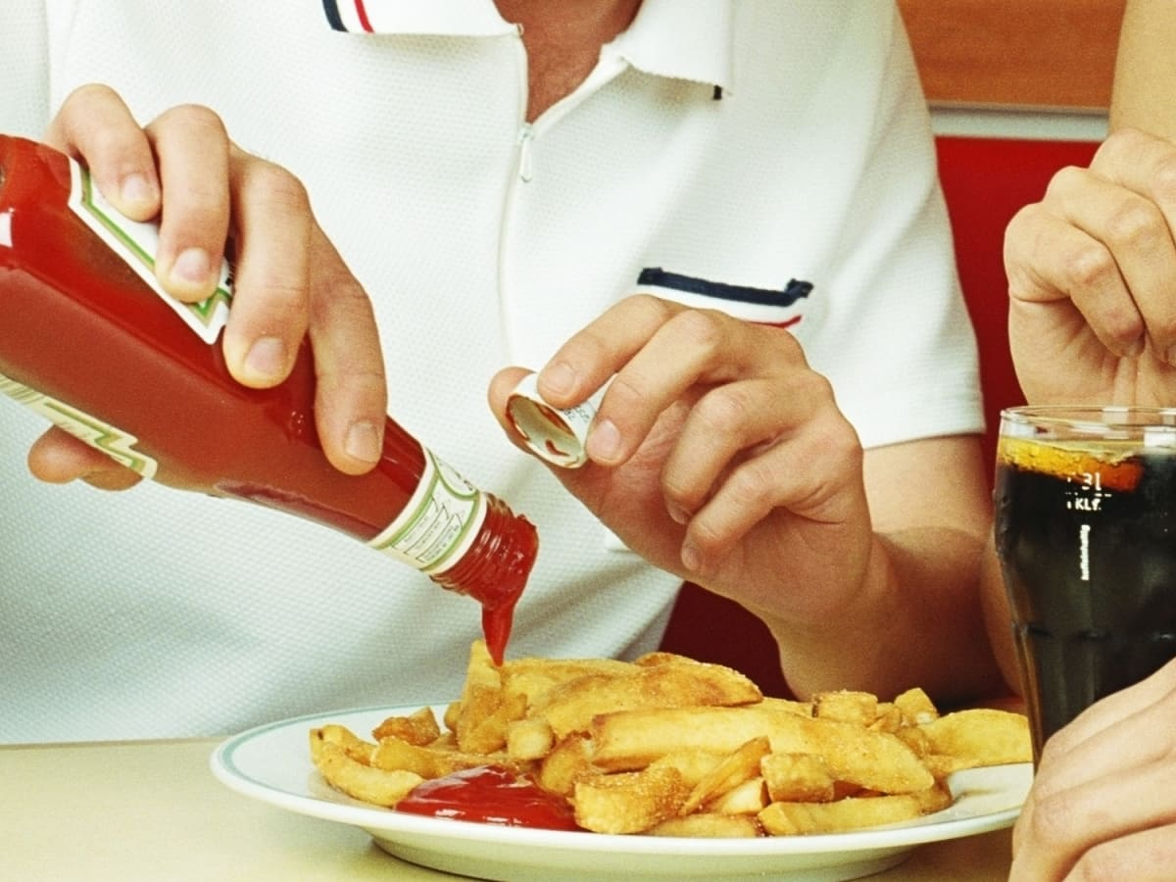


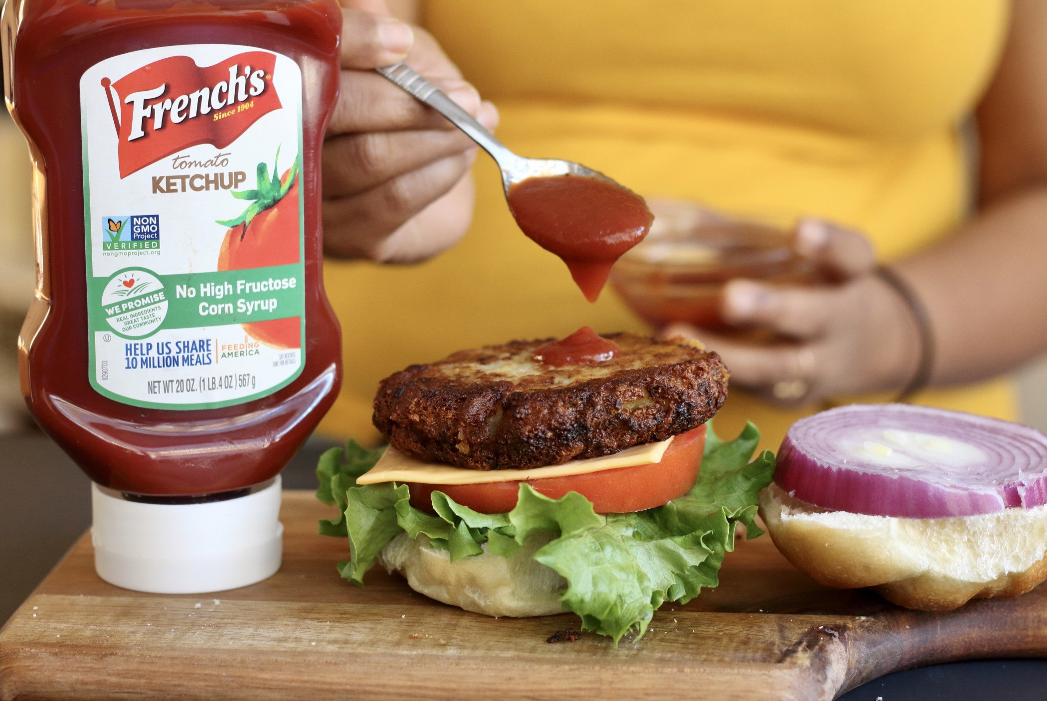

Slide 14
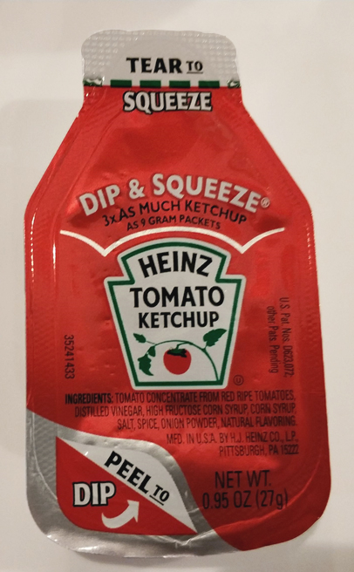

Slide 15
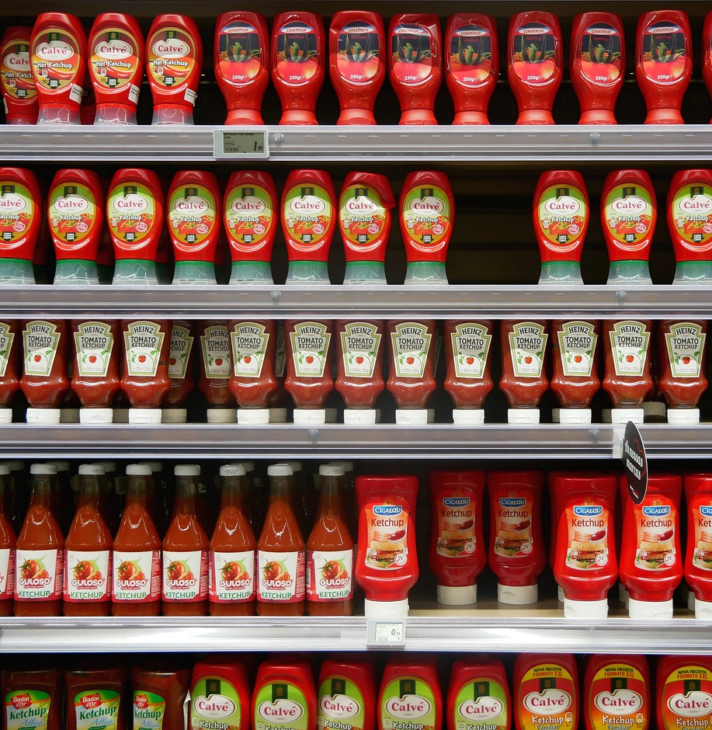

WHAT
HOW

Slide 16

!
?

Slide 17







!
?

Slide 18
!
?

Slide 19
1928374659847362

Slide 20
1928 3746 5984 7362

Slide 21

Thank you!
Jessica@EngstromJess.se
Social media
Name
Blog

